Slide 1
Bearing Design
ME 313: Mechanical Design
Week 10

Slide 2
Today’s Topics
Overview of Bearings
Rolling-contact bearings
Principles of rolling contact bearings
Type of rolling-contact bearings
Bearing life
Bearing reliability
Journal bearings
Principles of journal bearings
Theory of lubrication

Slide 3
Bearing Uses
Device that allows constrained motions between two or more components

Slide 4
Bearing Categories
Can be divided based on principles of operation or by allowed motions

Slide 5
Bearing Types by Allowed Motions
Axial rotation
Shaft rotation
Linear motion
drawer
Spherical rotation
Ball and socket joint (shoulder)
Hinged motion
Door, elbow, knee, etc.

Slide 6
Bearing Types by Principles of Operation
Plain bearing
Rolling-contact bearing
Fluid bearing
Jewel bearing
Magnetic bearing
Flexure bearing

Slide 7
Main Focus
Rolling-contact bearings
Journal bearings

Slide 8
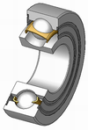
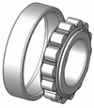
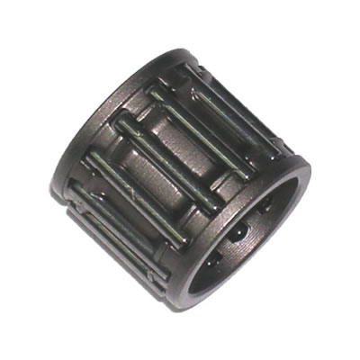
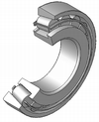
Rolling Element Bearings
Bearing have rolling elements, which allows relative motions between two surfaces without sliding
Rolling elements can be:
Balls
Needles
Cylinders (rollers)
Tapered rollers

Slide 9
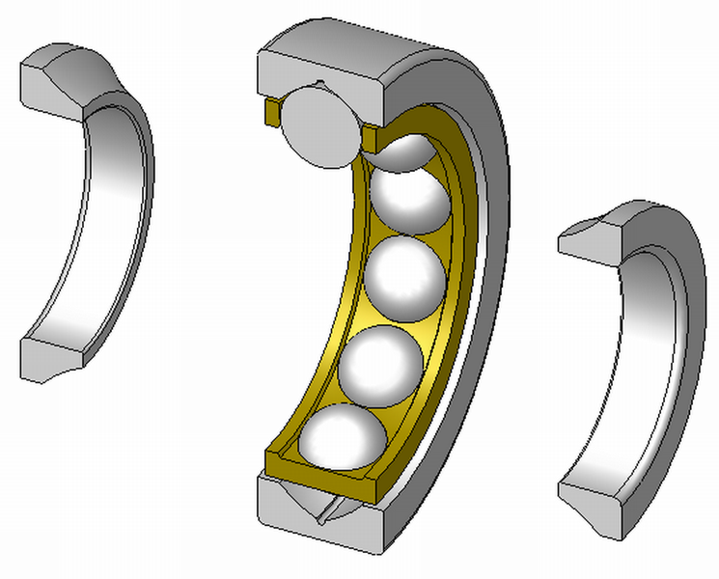
Ball Bearings
Use to reduce rotational friction and support radial and axial loads

Slide 10
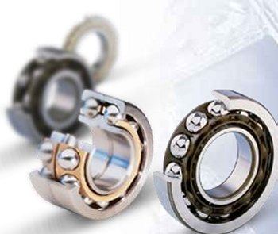
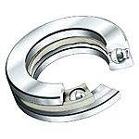
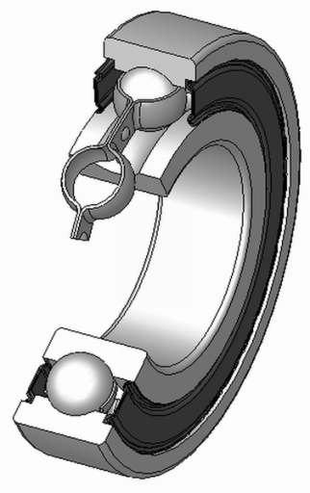
Typical Construction of Ball Bearing
Angular Contact
For radial and axial load
Axial
Mainly for axial load
Deep groove
Groove size is close to ball diameter, enhancing load resistance but limiting misalignment

Slide 11

Roller/Needle Bearings
Rollers are cylinders with slightly longer length than diameter
Needles are cylindrical rollers but with small diameter and long

Slide 12

Tapered Roller Bearings
Use to support large axial and radial load simultaneously
Rollers are tapered
Each is a part of a cone
Notes:
Cones that meet at a point can roll over each other without slipping

Slide 13
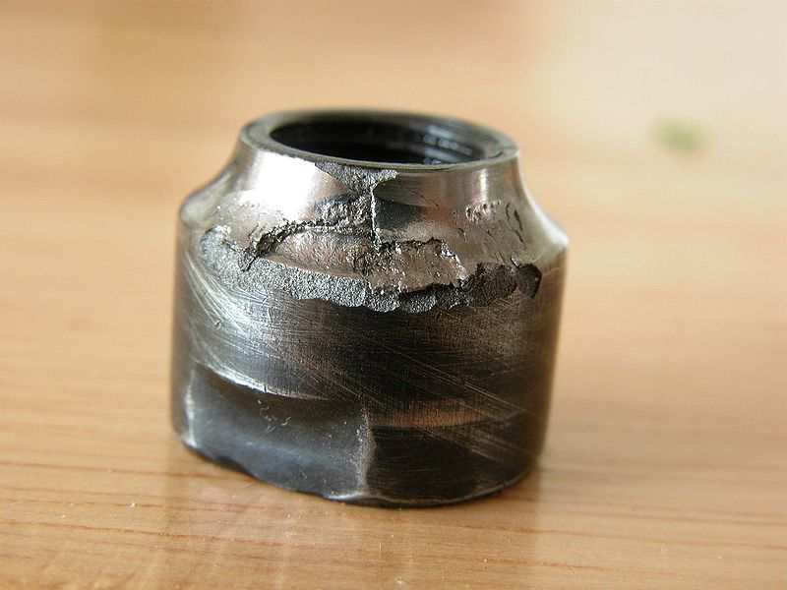
Rolling Element Bearing Failure
There are 3 major failure modes
Abrasion: heavy scratching on race surface
Fatigue: race or ball fracture due to repeated contact stress
Pressure-induced welding: metal bonding due to high pressure

Slide 14
Bearing Life
Bearing life is usually defined by
Number of revolutions of inner ring until first sign of failure
Number of hours of use at standard angular speed
Rating life is a term used by most manufacturers
number of revolutions or hours than 90% of bearings will achieve before failure develops, L₁₀

Slide 15
Bearing Load-Life Tradeoff at Constant Reliability
Data from regression shows that
F is exerted load on bearing
L is bearing life
a = 3 for ball bearing
a = 10/3 for roller bearings (cylindrical and tapered rollers)
Manufacturer choose to rate the load based on a set number of revolutions
The rated load is usually called catalog load rating, C₁₀

Slide 16
Catalog Load Rating and Rating Life
We can relate load requirement to expected bearing life by
Also can be converted to number of revolutions
L is life, in hours
n is angular speed, rev/min
Subscript:
R for rated
D for desired

Slide 17
Example

Slide 18
Bearing Survival: Reliability-Life Tradeoff
At constant load, the longer bearing works, the lower its chance to continue working
follows a Weibull distribution
R = reliability
x = life
x0 = guaranteed or minimum value of life
theta = characteristic parameter
b = shape parameter

Slide 19
Load-Life-Reliability
Combine the two previous equations, we have

Slide 20
Combined Radial and Thrust Loading
When there are both radial and thrust loads, equivalent load needs to be calculated to determine bearing life
depends on relative axial to radial load and whether inner or outer ring is rotating

Slide 21
General Form of Equivalent Load
General form can be written as
V = 1 for inner ring rotates, = 1.2 for outer
i = 1 when F_{a}/VF_{r} < e and i = 2 when F_{a}/VF_{r} > e
dependent on axial load compared to basic static load rating C₀
F_{a}/C₀ | e | F_{a}/VF_{r} < e |  | F_{a}/VF_{r} > e
 |  | X₁ | Y₁ | X₂ | Y₂
0.014 | 0.19 | 1 | 0 | 0.56 | 2.30
0.028 | 0.22 | 1 | 0 | 0.56 | 1.99
0.07 | 0.27 | 1 | 0 | 0.56 | 1.63
0.17 | 0.34 | 1 | 0 | 0.56 | 1.31
0.56 | 0.44 | 1 | 0 | 0.56 | 1.00

Slide 22
Example

Slide 23
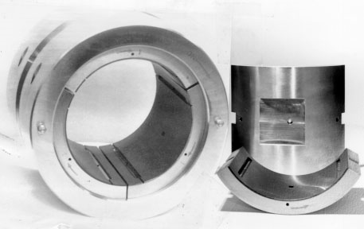
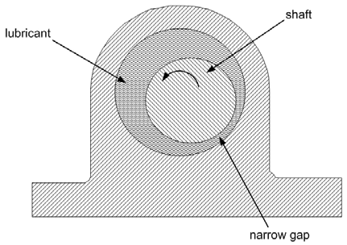
Journal Bearing
Make uses of lubrication to reduce friction
no direct contact between two surfaces

Slide 24
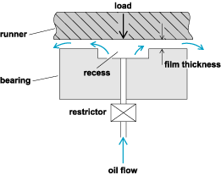
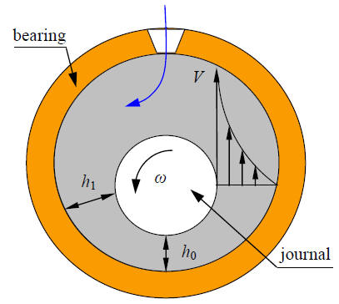
Types of Journal Bearings
Hydrostatically lubricated
external pump is needed to keep lubricant correctly pressurized
Hydrodynamically lubricated
lubricant is pressurized by the motion of surfaces

Slide 25
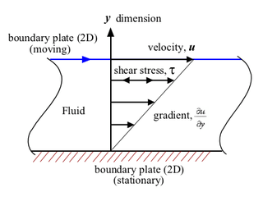
Theory of Lubrication
Required to understand the basics of how journal bearing works
Directly related to fluid mechanics

Slide 26
Petroff’s Equation
Assuming concentric shaft and housing
N is rotational speed (rev/s)
r is shaft radius
c is shaft-housing clearance
Torque on the shaft is

Slide 27
Frictional Torque
Consider for W on bearing
pressure on shaft projected area is
frictional force is
torque due to friction is

Slide 28
Equivalent Coefficient of Friction
This is called Petroff’s equation
provides quick estimates for coefficient of friction of lightly loaded bearing
Two important quantities to lubrication are

Slide 29
Heat Generated in Journal Bearing
Constant shearing increases temperature of lubricant
flow rate of lubricant through a clearance is
Heat loss by convection and radiation is
Heat generated is from frictional torque

Slide 30
Lubricant Temperature
At steady state, heat generated is equal to heat loss
Lubricant temperature usually should not go above approximately 120 C
unless lubricant manufacturer states a higher number

Slide 31
Example

